Slide 1
N-Queens through CSP in Kotlin
Corey Reichel

Slide 2
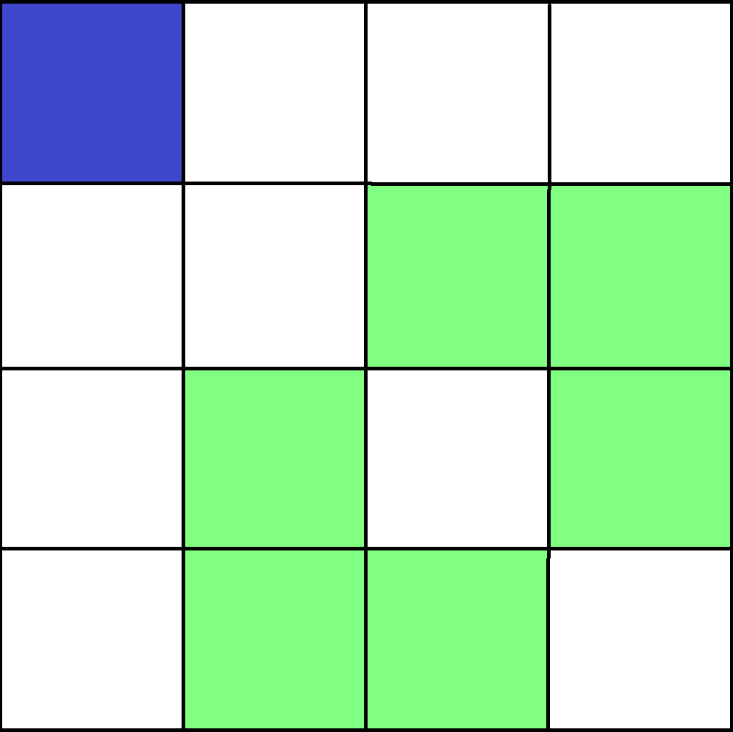
N-Queen’s puzzle
Place N queens on a N*N
Cannot occupy the same Row, Column, Diagonal, Anti-diagonal

Slide 3
Constraint satisfaction Problems
State: All variables and their values that denote a static environment
Number of queens, where they are placed etc.
Action: How to move from state to state
Place a queen
Constraints:
Row, col, diag, anti diag,
Solution: A state that has N queens and follows the constraints

Slide 4
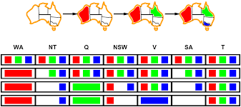
Forward Checking

Slide 5
Arc consistency
After initial trim (from forward checking)
Check the implications of the current state
Repeat until no new implications arise

